Slide 1

Methods for Causal Inference in Educational Research
January/February 2022
Isa Steinmann

Slide 2
9 | Regression Discontinuity Designs II Time: 14 February 2022, 12:15-14:00h Main instructor: Isa Steinmann Required reading: Luyten (2006)
10 | Differences-in-Differences Designs I Time: 17 February 2022, 12:15-14:00h Main instructor: Isa Steinmann Required reading: Angrist & Pischke (2015), chapter 5
11 | Differences-in-Differences Designs II Time: 21 February 2022, 12:15-14:00h Main instructor: Isa Steinmann Required reading: Strello, Strietholt, Steinmann, & Siepmann (2021)
12 | Lessons Learned and Closing Time: 23 February 2022, 12:15-14:00h Main instructor: Isa Steinmann Required reading: Rutkowski & Delandshere (2016)
9 | Regression Discontinuity Designs II Time: 14 February 2022, 12:15-14:00h Main instructor: Isa Steinmann Required reading: Luyten (2006)
10 | Differences-in-Differences Designs I Time: 17 February 2022, 12:15-14:00h Main instructor: Isa Steinmann Required reading: Angrist & Pischke (2015), chapter 5
11 | Differences-in-Differences Designs II Time: 21 February 2022, 12:15-14:00h Main instructor: Isa Steinmann Required reading: Strello, Strietholt, Steinmann, & Siepmann (2021)
12 | Lessons Learned and Closing Time: 23 February 2022, 12:15-14:00h Main instructor: Isa Steinmann Required reading: Rutkowski & Delandshere (2016)
9 | Regression Discontinuity Designs II Time: 14 February 2022, 12:15-14:00h Main instructor: Isa Steinmann Required reading: Luyten (2006)
10 | Differences-in-Differences Designs I Time: 17 February 2022, 12:15-14:00h Main instructor: Isa Steinmann Required reading: Angrist & Pischke (2015), chapter 5
11 | Differences-in-Differences Designs II Time: 21 February 2022, 12:15-14:00h Main instructor: Isa Steinmann Required reading: Strello, Strietholt, Steinmann, & Siepmann (2021)
12 | Lessons Learned and Closing Time: 23 February 2022, 12:15-14:00h Main instructor: Isa Steinmann Required reading: Rutkowski & Delandshere (2016)

Slide 3
Take-away messages
!
RDD can be applied to isolate the effects of age and schooling on scholastic outcomes
Decision to apply sharp instead of fuzzy RDD must be well-justified if there are non-compliers
When applying RDD, one must check if RDD requirements are met (e.g., What Works Clearinghouse)
Regression discontinuity “doesn’t work for all causal questions, but it works for many. And when it does, the results have almost the same causal force as those from a randomized trial” (Angrist & Pischke, 2015, p. 147)

Slide 4
Overview
Easy versus tight money example
Group exercise

Slide 5
?
What do you remember from chapter 5 in
Angrist & Pischke (2015)?

Slide 6

https://www.youtube.com/watch?reload=9&v=eiffOVbYvNc&feature=youtu.be
Notes:
11 minutes

Slide 7
Easy versus tight money
What is the outcome?
What is the treatment?
What is the sample?
What is the assumed causal mechanism?
Can we assume ceteris paribus?
What is the treatment effect?
What are limitations of the study?
?
Angrist & Pischke (2015)

Slide 8
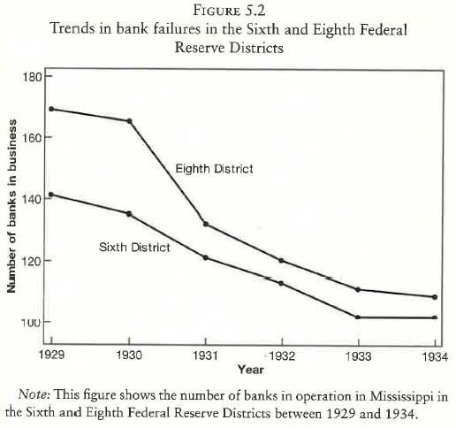
Easy versus tight money
What is the outcome?
Number of banks in business
What is the treatment?
Fed. Banks’ easy (vs. tight) money lending policy
What is the sample?
Two districts in Mississippi (1 treatment, 1 control)
What is the assumed causal mechanism?
Money from federal bank helps over crisis
Can we assume ceteris paribus?
Both districts in Mississippi
Parallel trends in absence of treatment
What is the treatment effect?
Less bank closures than in control condition
What are
limitations of the study?
Generalizability?
Other explanations?
Angrist & Pischke (2015), p. 185

Slide 9
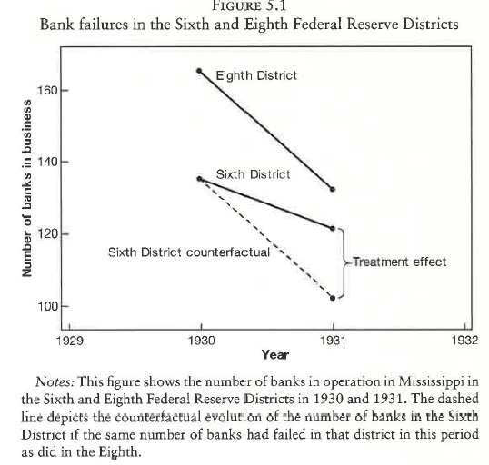
Easy versus tight money
What is the outcome?
Number of banks in business
What is the treatment?
Fed. Banks’ easy (vs. tight) money lending policy
What is the sample?
Two districts in Mississippi (1 treatment, 1 control)
What is the assumed causal mechanism?
Money from federal bank helps over crisis
Can we assume ceteris paribus?
Both districts in Mississippi
Parallel trends in absence of treatment
What is the treatment effect?
Less bank closures than in control condition
What are limitations of the study?
Implications?
Generalizability?
Other explanations?
…
Angrist & Pischke (2015), p. 184

Slide 10
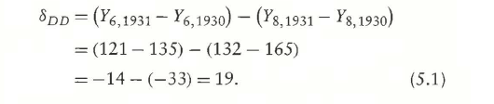
Easy versus tight money
Simplest DD analysis: two measurement points and two groups
Difference between
Pre-/post-difference in treatment condition
Pre-/post-difference in control condition
Conclusion that if sixth district had not enjoyed easy lending policy, 19 more banks would have been closed (counterfactual)
→ Difference in difference
Angrist & Pischke (2015), p. 184

Slide 11
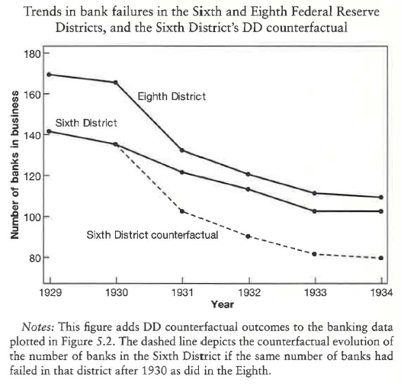

Easy versus tight money
Taking more trend data into account:
Note that from 1931 onwards, easy money policy also in eighth district
Disentangling:
General differences between treatment and control condition (TREAT)
General changes from 1931 onwards (POST)
Changes from 1931 onwards due to treatment (TREAT * POST)
Conclusion that if sixth district had not enjoyed easy lending policy, 21 more banks would have been closed (counterfactual)
Angrist & Pischke (2015), p. 186

Slide 12
Differences-in-differences approach
“The differences-indifferences (DD) method recognizes that in the absence of
random assignment, treatment and control groups are likely to differ for many reasons. Sometimes, however, treatment and control outcomes move in parallel in the absence of treatment. When they do, the divergence of a post-treatment path
from the trend established by a comparison group may signal a treatment effect”
Importance of common trends assumption (i.e., parallel in absence of treatment)
Importance of time perspective
Angrist & Pischke (2015), p. 178

Slide 13
?
Questions so far?

Slide 14
Group exercise
…
Imagine a hypothetical application for DD approach:
What is the outcome?
What is the treatment?
What is the sample?
What is the assumed causal mechanism?
Can we assume ceteris paribus?
What is the expected treatment effect?
What are limitations?

Slide 15
Take-away messages
!
DD can be applied if different development between treatment and control group and common trends in absence of treatment
In this case, ceteris paribus can be assumed
Common trends assumption should be theoretically and, if possible, empirically be justified
DD requires repeated cross-sectional or longitudinal panel data

Slide 16
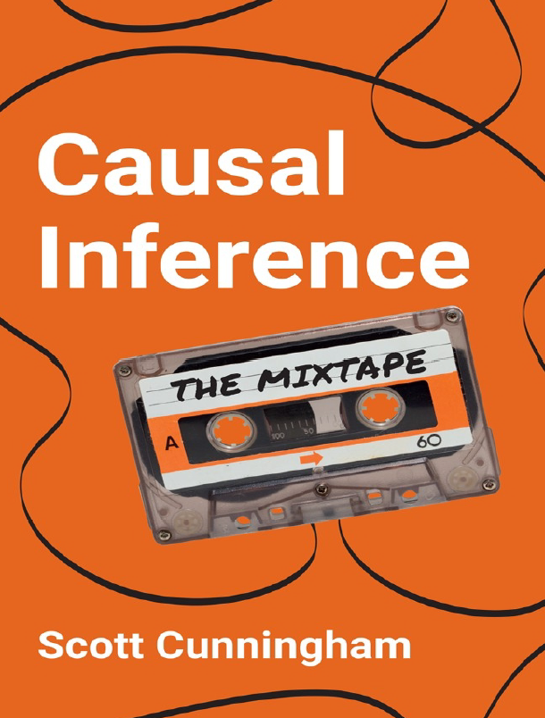

Recommended literature
Cunningham, S. (2021). Causal inference: The mixtape. Yale University Press
Angrist, J. D. & Pischke, J.-S. (2009). Mostly harmless econometrics. An empiricist’s companion. Princeton University Press

Slide 17
9 | Regression Discontinuity Designs II Time: 14 February 2022, 12:15-14:00h Main instructor: Isa Steinmann Required reading: Luyten (2006)
10 | Differences-in-Differences Designs I Time: 17 February 2022, 12:15-14:00h Main instructor: Isa Steinmann Required reading: Angrist & Pischke (2015), chapter 5
11 | Differences-in-Differences Designs II Time: 21 February 2022, 12:15-14:00h Main instructor: Isa Steinmann Required reading: Strello, Strietholt, Steinmann, & Siepmann (2021)
12 | Lessons Learned and Closing Time: 23 February 2022, 12:15-14:00h Main instructor: Isa Steinmann Required reading: Rutkowski & Delandshere (2016)
9 | Regression Discontinuity Designs II Time: 14 February 2022, 12:15-14:00h Main instructor: Isa Steinmann Required reading: Luyten (2006)
10 | Differences-in-Differences Designs I Time: 17 February 2022, 12:15-14:00h Main instructor: Isa Steinmann Required reading: Angrist & Pischke (2015), chapter 5
11 | Differences-in-Differences Designs II Time: 21 February 2022, 12:15-14:00h Main instructor: Isa Steinmann Required reading: Strello, Strietholt, Steinmann, & Siepmann (2021)
12 | Lessons Learned and Closing Time: 23 February 2022, 12:15-14:00h Main instructor: Isa Steinmann Required reading: Rutkowski & Delandshere (2016)
9 | Regression Discontinuity Designs II Time: 14 February 2022, 12:15-14:00h Main instructor: Isa Steinmann Required reading: Luyten (2006)
10 | Differences-in-Differences Designs I Time: 17 February 2022, 12:15-14:00h Main instructor: Isa Steinmann Required reading: Angrist & Pischke (2015), chapter 5
11 | Differences-in-Differences Designs II Time: 21 February 2022, 12:15-14:00h Main instructor: Isa Steinmann Required reading: Strello, Strietholt, Steinmann, & Siepmann (2021)
12 | Lessons Learned and Closing Time: 23 February 2022, 12:15-14:00h Main instructor: Isa Steinmann Required reading: Rutkowski & Delandshere (2016)

Slide 18
Thanks for your attention!
Isa Steinmann
isa.steinmann@cemo.uio.no

Slide 19
References
Angrist, J. & Pischke, J.-S. (2015). Mastering `Metrics: The Path from Cause to Effect. Princeton University Press

